Slide 1
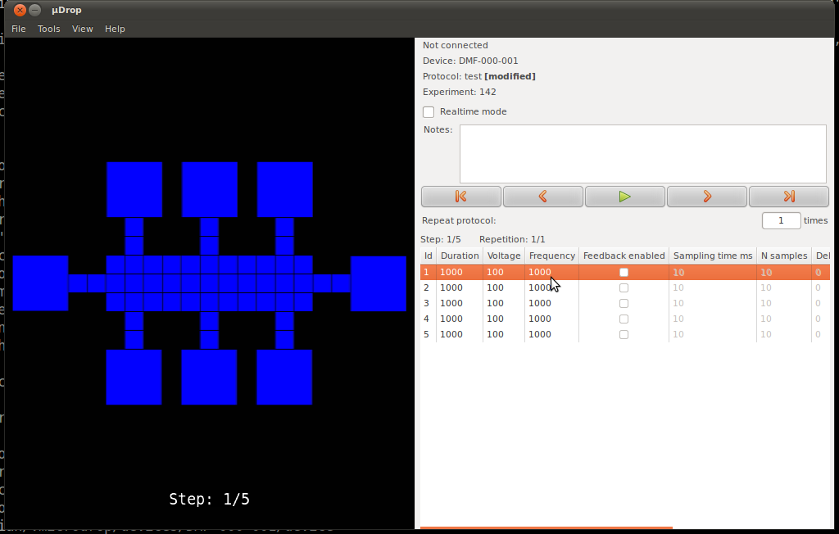
Microdrop:
plugin development
Christian Fobel
May 25, 2012

Slide 2
Overview
Main goals for this tutorial
  provide a general idea of what can be accomplished through writing a plugin
  demonstrate the basic requirements for developing a plugin
    signal-handling
    plugin options

Slide 3
Application overview

Slide 4
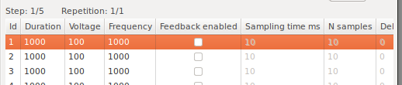
Terminology
Protocol
  sequence of "steps"
  e.g., sequence of electrode activations to move a drop
Step
  execution step of a protocol
  each step has a state associated with it

Slide 5
Creating a protocol
Create one or more steps
For each step, set the desired options
  values can be modified in the protocol grid view

Slide 6
Protocol playback
Protocols can be played back by pressing "Play" button
Starting at the currently selected step, each step will be cycled through, in order
At each step, the options corresponding to the current step are set

Slide 7
What is a plugin?
Packaged code that extends the functionality of an application
Responds to events that occur in the program
Example:
  dmf_control_board plugin:
    controls the switching board to activate the selected electrodes for the current protocol step
Potential plugin ideas:
  control the position of a motor, magnet, etc. based on the current step
  perform image processing on a video frame

Slide 8
Signals
Notification that an event has occurred in the program
For example:
  a new step is created
  protocol "play" button is pressed
  step selection has changed
Most signals fall into four categories
  protocol signals
  step signals
  step options signals
  app options signals

Slide 9
Protocol signals
on_protocol_run
  emitted when "play" button is pressed
on_protocol_pause
  emitted when either
    "pause" button is pressed
    protocol finishes running
on_protocol_created
  a new protocol is created
on_protocol_swapped
  an existing protocol is loaded

Slide 10
Step signals
on_step_created
  a new step is created
on_step_swapped
  another existing step is selected (or transitioned to in playback mode)
on_step_options_changed
  the options for a step are modified
    e.g.,
      a new electrode is activated on the DMF device view
      the actuation voltage is changed

Slide 11
Options
Basic data types
  boolean, integer, string, file path, directory path, etc.
App options
  application-level settings
  apply to all protocols
  e.g., video overlay opacity
Step options
  options to apply on a per-step basis
  e.g., state of electrode channels, voltage, frequency, duration, etc.

Slide 12
Plugins
How do we make use of these signals and options?
Write a plugin!
In fact, all core application functionality is handled by plugins
  e.g., DMF device view plugin
Working example
  VideoFrameGrabber
    grab a video frame on each step transition
    write each grabbed video frame to disk

Slide 13
Handling signals
How do we request to be notified of a particular signal?
Implement appropriate class method
Example:
  add on_step_swapped() handler to VideoFrameGrabber plugin
  handles any transition from one step to another

Slide 14
App fields
Remember app options?
We can define our own!
Add AppFields to our plugin class
  AppFields defines a list of fields for which a value should be saved for the plugin
  a "field" specifies the type and validating restrictions for a corresponding "option" value
    "field" -> type (think int, bool, string, etc.)
    "option" -> value (think 0, True, "hello", etc.)
Example:
  add output directory option to VideoFrameGrabber

Slide 15
Step fields
Don't forget about step options!
Adding StepFields is similar to AppFields
  StepFields defines list of fields for which values should be stored for each step of a protocol
Example
  add grabber_enabled step field
    specify whether or not a video frame should be saved when transitioning to the current step

Slide 16
Advanced topics
There are many things not covered today
  each AppField/StepField can be configured to not show in the GUI
    useful for types that do not have an appropriate GUI widget available
      e.g., the state of electrode channels
        not in protocol grid with the rest of the step fields
  schedule requests can be made to ensure signals are processed in a particular order, when necessary
    e.g., during playback, a motor might need to finish moving into position before activating a temperature probe

Slide 17
Stay tuned...
These slides and more info will be made available at:
  https://github.com/wheeler-microfluidics/microdrop/wiki/Developer-Guide

