Slide 1
Jeffrey Richter, Chapter 4
Containers vs Hyper-V Containers
Containers and Orchestrators
Continuous Integration and Delivery

Slide 2
Containers and Hyper-V Containers
Tips:
Docker is not a virtualization system. Docker is a containerization system. Your container organized by Docker may use different virtualization systems.
Hypervisors needed only in case your host is not a Linux Machine
To execute container runtime Docker uses containerd (or another type of docker runtime engine): https://www.cloudsavvyit.com/10075/what-is-containerd-and-how-does-it-relate-to-docker-and-kubernetes/#:~:text=Docker%20%E2%80%93%20A%20developer%2Doriented%20software,relatively%20high%20level%20container%20interface.
Difference:
Hyper-V container may run only on Windows OS (in most cases: Windows Server 2016 and later)
Different isolation level (Hyper-v has an additional level of isolation)
Different performance on VM and on Bare Metal for different kinds of containers (Hyper-v works faster in theory)
Different size (Hyper-v container might be larger than “alpine” containers, even “hyper-v nano” container type is larger)

Slide 3
Hyper-V Containers
Windows Hyper-v container is a windows server or Linux container that runs on VM with Windows OS.
Every hyper-v container creates its own VM.
This means there is no kernel sharing between the different hyper-v containers. This is useful in case where additional level of isolation is needed by customers who don’t like the traditional kernel sharing done by containers.
The same Docker image and CLI can be used to manage hyper-v containers.
Creation of hyper-v containers is specified as a runtime option:
docker run -it --isolation=hyperv microsoft/nanoserver cmd

Slide 4
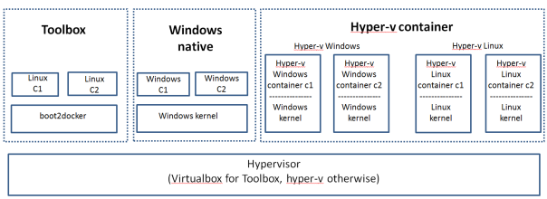
Hyper-V Containers
There are 2 modes of hyper-v container.
Windows hyper-v container – Here, hyper-v container runs on top of Windows kernel. Only Windows containers can be run in this mode.
Linux hyper-v container – Here, hyper-v container runs on top of Linux kernel. This mode was not available earlier and it was introduced as part of Dockercon 2017. Any Linux flavor can be used as the base kernel. Docker’s Linuxkit project can be used to build the Linux kernel needed for the hyper-v container. Only Linux containers can be run in this mode.

Slide 5
Hyper-V Containers
Is it worth?
Short answer: No.
Why?
https://forums.docker.com/t/hyper-v-or-native-windows-containers/44631/4
https://sreeninet.wordpress.com/2017/05/13/docker-for-windows-different-modes/
https://www.stratoscale.com/blog/containers/running-containers-on-bare-metal/

Slide 6
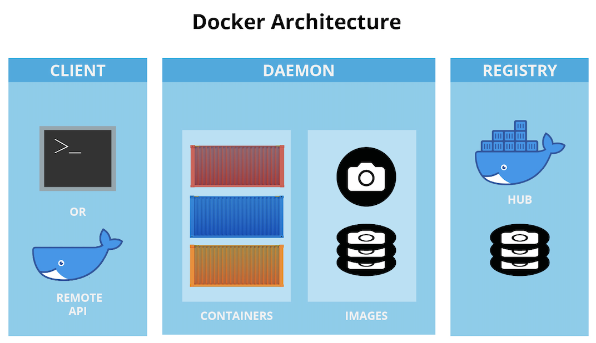
Container Orchestration by Docker
Docker Image is immutable. You are not able to mutate it once it built
To compare images (in order to understand whether it has the image locally) Docker Daemon uses hash. Otherwise, it goes to remote registry (default or your private registry)
You may specify the amount of memory, processors and cores for each container

Slide 7
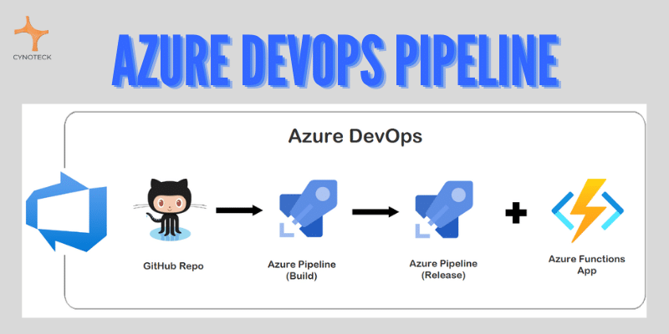
CI\CD processes. CI\CD in Azure & AWS
Difference:
CI stands for continuous integration, a fundamental DevOps best practice where developers frequently merge code changes into a central repository where automated builds and tests run.
But CD can either mean continuous delivery or continuous deployment.

Slide 8
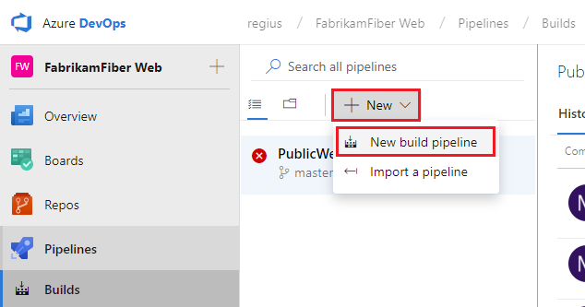
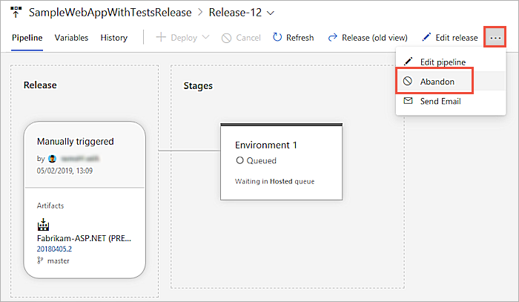
Azure DevOps (ADO)
In Azure DevOps you may find two kinds of automatic operations:
Pipelines – CI operations consisted of steps. May be triggered by code changed in your repository to run build and test commands.
Releases – CD (deployment and delivery).
Meaning: step, steps or even complex mesh of steps which declare what to do. Example: create an image with specific parameters, place it to ACI, trigger different functions and so on.

Slide 9
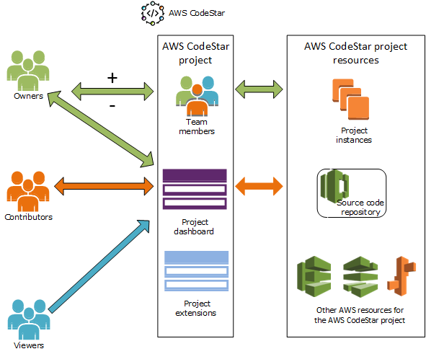
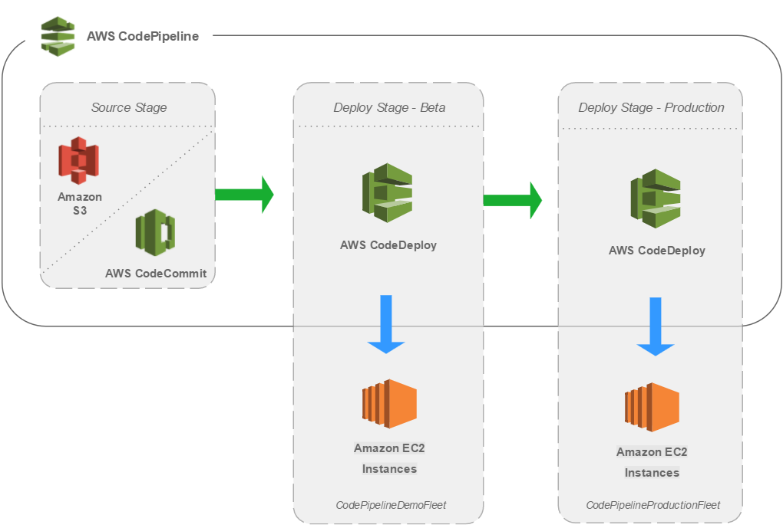
AWS CodeDeploy, CodeCommit, CodeStar, CodeBuild. Jenkins
AWS has dozens of specific services each of them serves you in specific situations: code check, code commit and build, deployment.
CodeStar – integration between teams, their boards, code repos and build processes. (in ADO – Azure Boards + Azure Repos + Azure Pipelines)
CodeDeploy – service which automates code delivery to your EC2 \ ECS.
PS: The more I know in AWS the less I like it.

