Slide 1
Architecting Distributed Cloud Applications
Part 2 – Regions and Microservices

Slide 2
Agenda
Recap
Regions, availability zones and fault domains
Discussion
Conclusion
Microservices: what and why

Slide 3
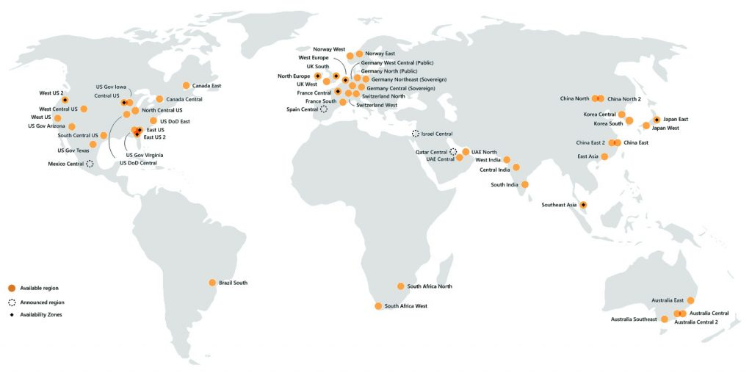
Regions
Azure
https://jachoos.net/microsoft-azure-datacenter/

Slide 4
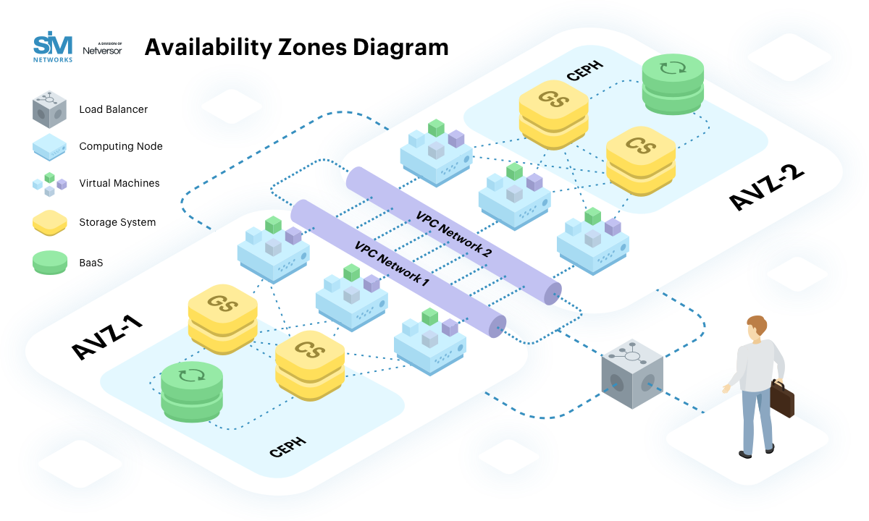
Availability zones
A common misconception is that a single zone equals a single data center. In fact, each zone is backed by one or more physical data centers, with the largest backed by five. While a single availability zone can span multiple data centers, no two zones share a data center
https://www.rackspace.com/blog/aws-101-regions-availability-zones

Slide 5
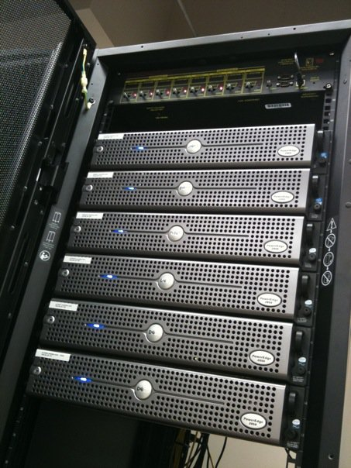
Inside data center - Rack, PC, VM

Slide 6
Fault domains
Single point of failure - is a part of a system that, if it fails, will stop the entire system from working. https://en.wikipedia.org/wiki/Single_point_of_failure
Why it is important to distribute your application instances across multiple fault domains?
What are the drawbacks of service replication across multiple fault domains?

Slide 7
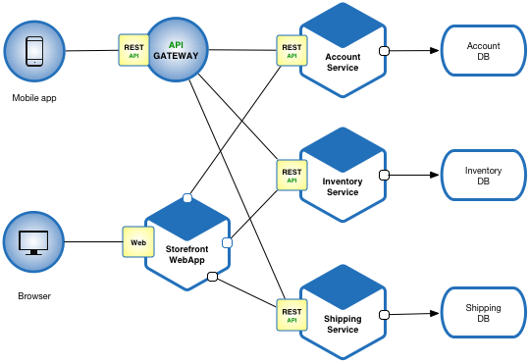
Microservices – What?
Microservices vs Monolith
Solves a domain specific problem and has exclusive access to its own data store
Decoupled but not completely independent
If one service fails what happens to the application?

Slide 8
Microservices – Why?
It is not universally defined: you can find different opinions!
What Richter thinks:
Scale independently
Different technology stacks
More than one client: adopt new features at will
Conflicting dependencies

Slide 9
Microservices – maybe it’s not for you?
What are the biggest shortcomings of microservices?
Do benefits of microservices always outweigh shortcomings?
What about SLA of a microservice application?
Each dependent microservice reduces application’s SLA
https://dzone.com/articles/microservices-basics

Slide 10
Conclusions

