Slide 1
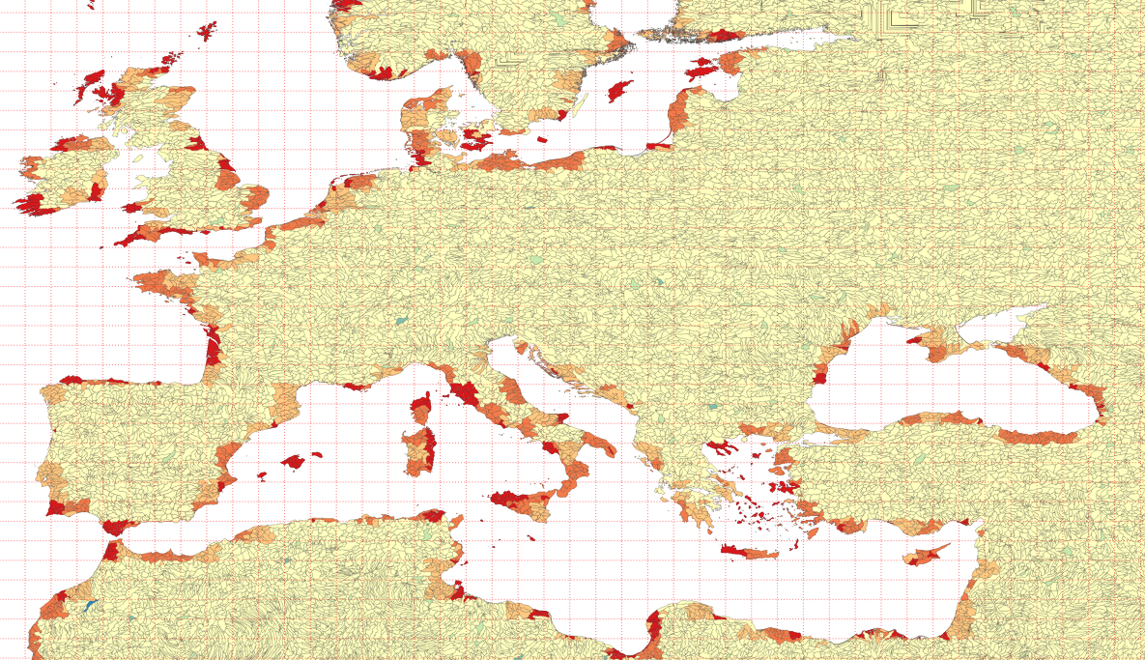
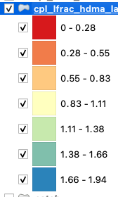
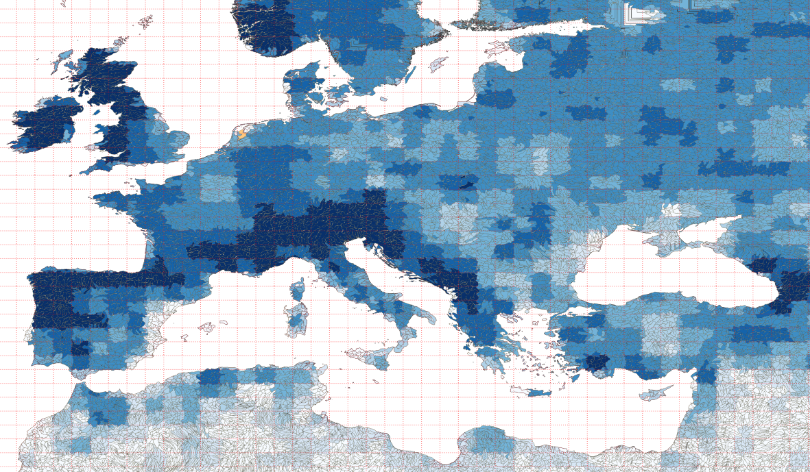
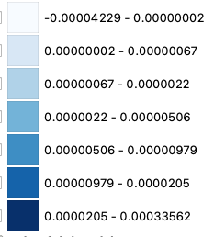
No lake (f09_f09 + rHDMA)
Med_frac_rof_lfrac
total_rof_imported

Slide 2
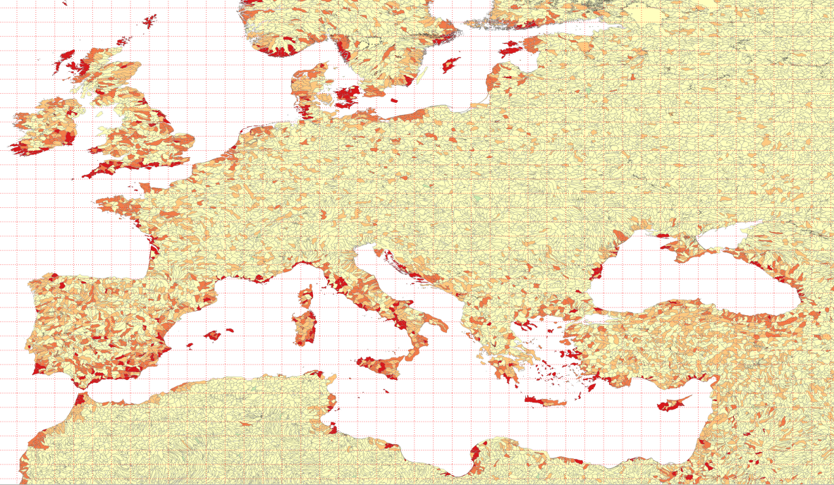
lake (f09_f09 + rHDMAlk)
Med_frac_rof_lfrac
total_rof_imported

Slide 3
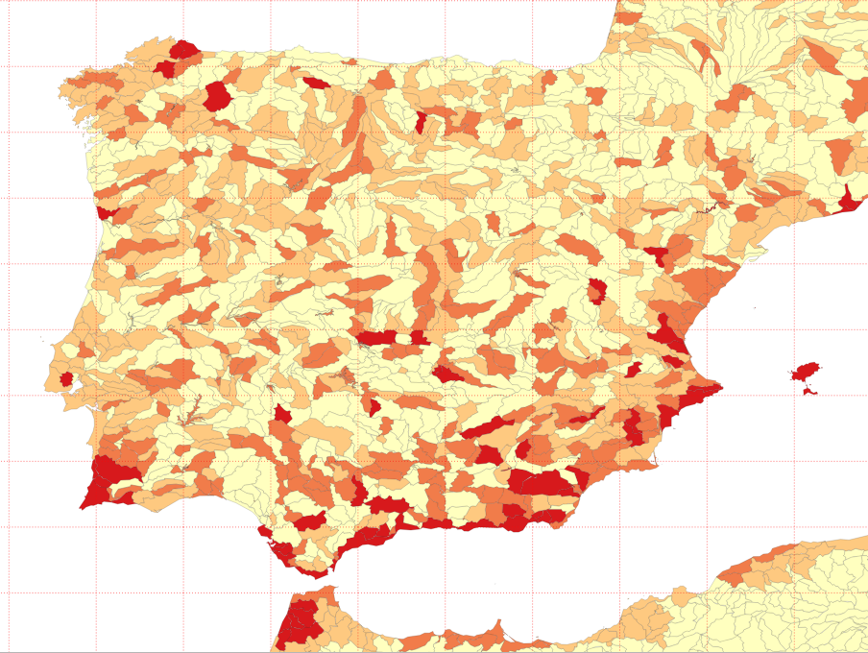

Slide 4
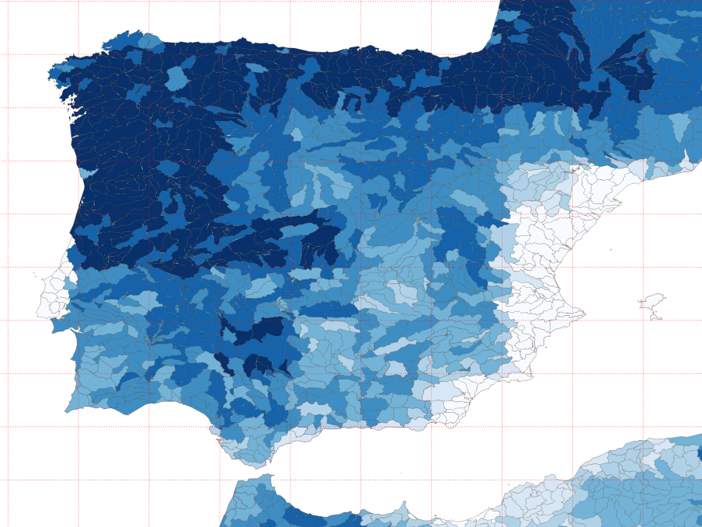

Slide 5
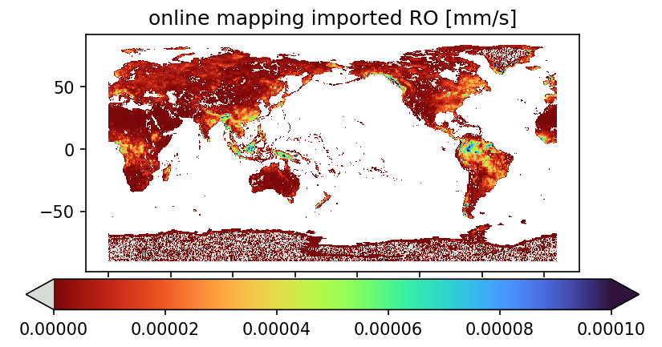
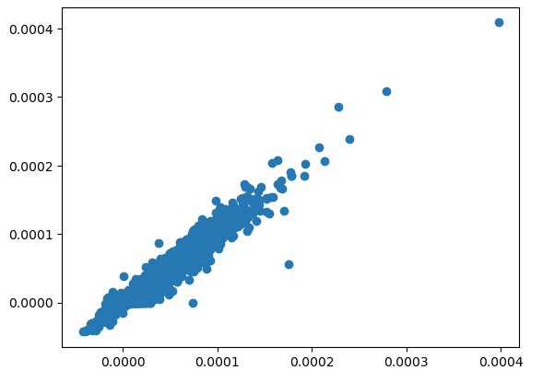
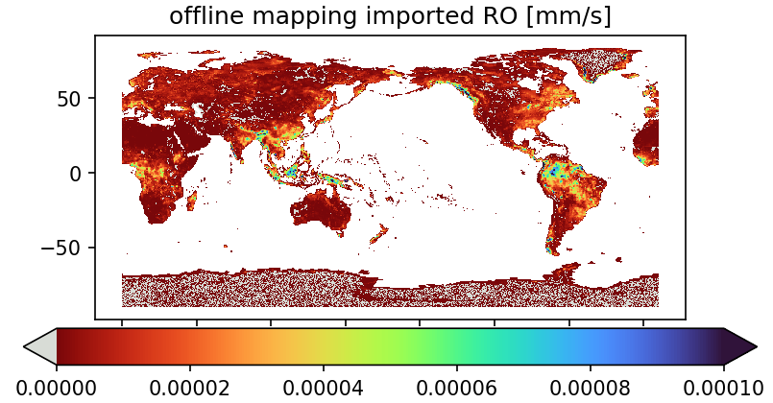
hcru_hcru_mt13
online mapping vs offline mapping
LND->ROF runfoff
imported runoff (Off-line mapping) mm/s
imported runoff (On-line mapping) mm/s

Slide 6
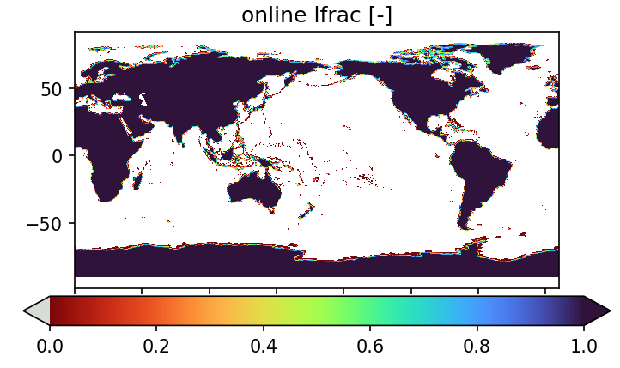
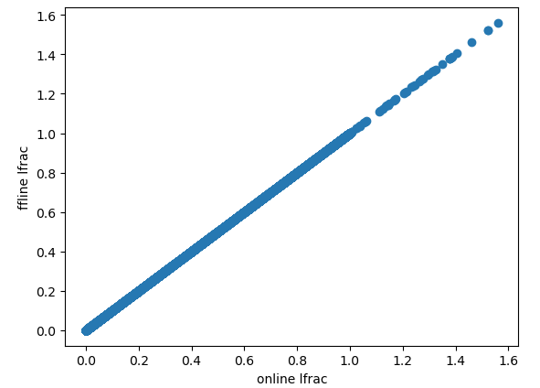
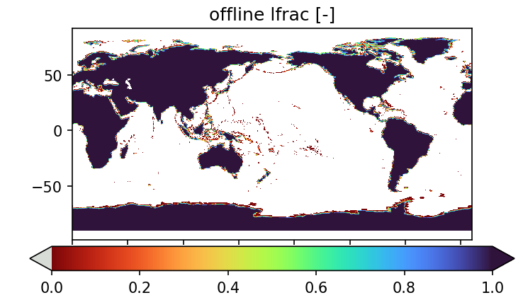
hcru_hcru_mt13
online mapping vs offline mapping
LND->ROF runfoff

