Slide 1
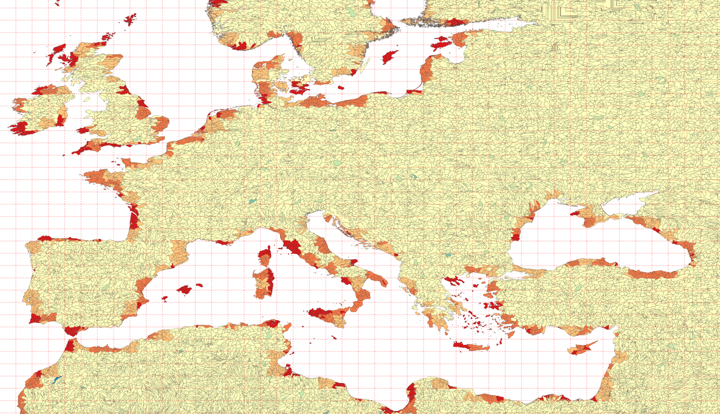
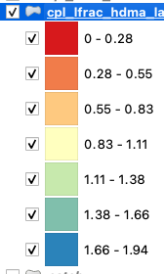
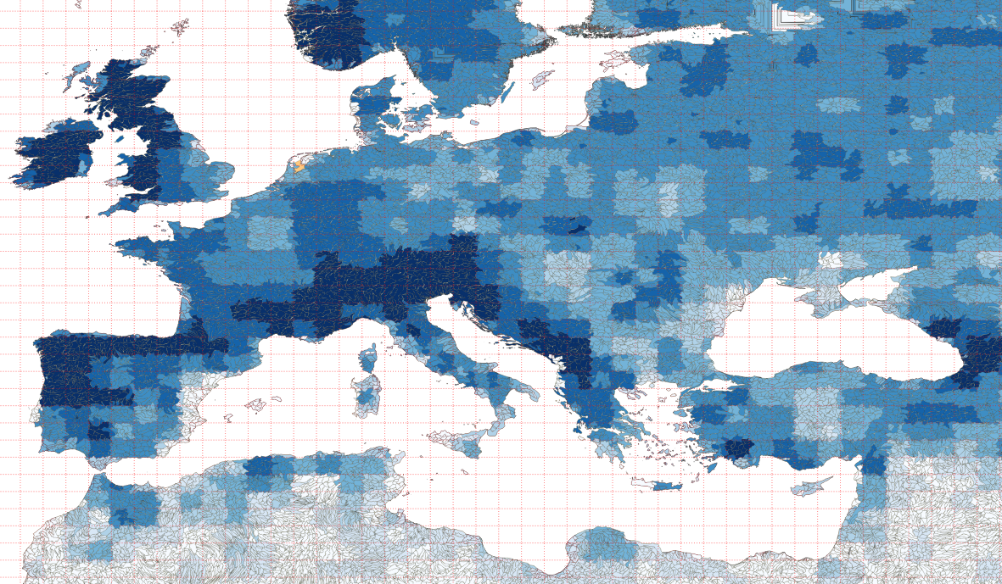
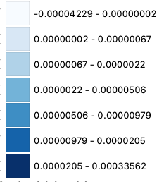
No lake (f09_f09 + rHDMA)
Med_frac_rof_lfrac
total_rof_imported

Slide 2
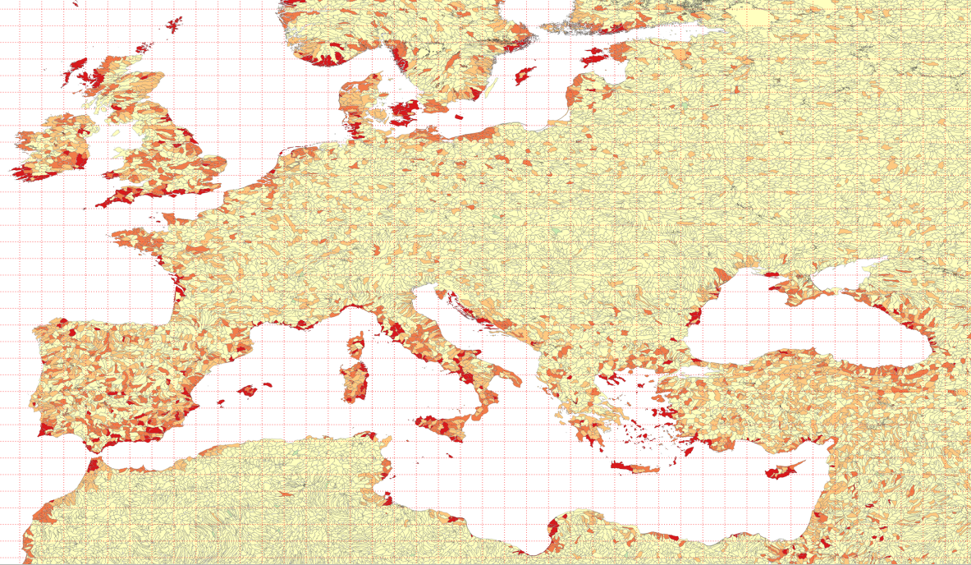
lake (f09_f09 + rHDMAlk)
Med_frac_rof_lfrac
total_rof_imported

Slide 3
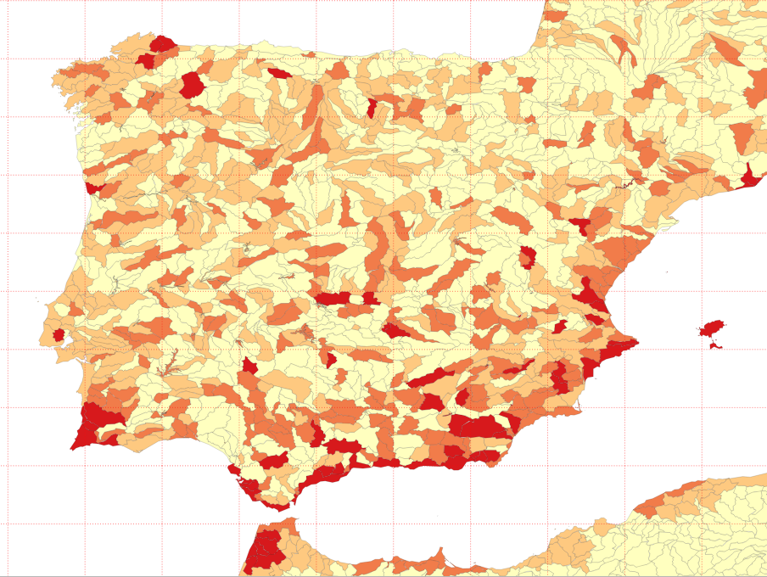

Slide 4
